Slide 1
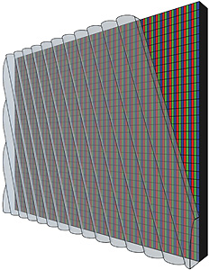
Lenticular lens (光柵透鏡)

Slide 2
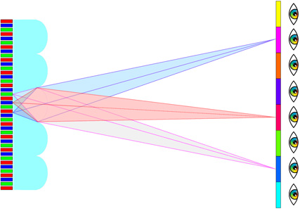
Lenticular lens (光柵透鏡)

Slide 3
Alioscopy Pixel Interleaving

Slide 4
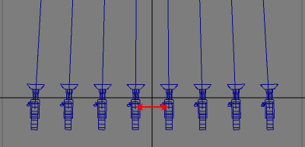
Multiple views

