Slide 1
Digital Circuits and Electronics 數位電子與數位電路關聯圖
Syllabus & Related Courses Diagram

Slide 2
數位電子與數位電路關聯圖 資訊工程學系相關科目
一上 計算機程式設計 ,計算機概論(選修)
二上 數位電子與數位電路
二下 數位系統與實驗
三上 自動機與形式語言(for sequential circuits design) ,
計算機結構
銜接研究所課程: 連網型嵌入式系統,高等計算機結構,多核心系統與軟體,類比積體電路, 通訊積體電路設計

Slide 3
你想學會的項目: 這門課打基礎
Abstraction, layers of layers of abstraction
程式如何在電腦上執行?
電腦的結構(organization, architecture)是甚麼?
CPU, Memory, Control Circuits 如何設計, 是什麼半導體元件組成?
Moor’s Law 是甚麼? 我們快到極限了嗎?
3D IC是甚麼? Cloud Computing 能否解決或繞過Moor’s Law極限?

Slide 4
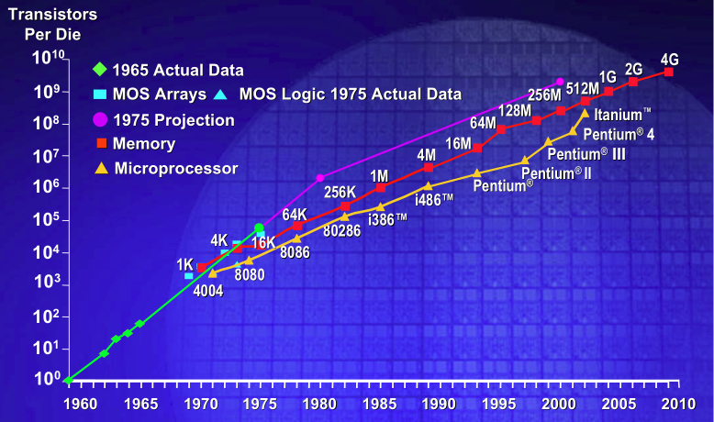
Moor’s Law

Slide 5
極限: shrinking of process technologies
"Semiconductor technological development will be faced with bottlenecks within the next 10 years, with Moore's Law to witness insurmountable technological barriers in 6-8 years, according to Morris Chang, chairman of Taiwan Semiconductor Manufacturing Company (TSMC).
Nevertheless, Moore's Law may soon encounter a bottleneck, Chang indicated. While the continuously shrinking of process technologies poses a challenge to the industry, companies will need other design innovations to extend Moore's Law beyond its expected limits, Chang noted."

Slide 6
新舊差異: 以下課程改選修或合併 （99年度起入學學生適用 VS. 96年度起入學學生適用
計算機概論, 資訊系統原理
計算機組織與組合語言
數位系統設計 與 數位電路實驗 合併
PS: 系訂必修54 學分,專業選修課程至少27 學分 共同必修科目12 學分,通識教育科目18 學分
舊制: 系訂必修78 學分

Slide 7
Syllabus(i), MIT 2007
1. Understand the basic electrical engineering principles and abstractions on which the design of electronic systems is based. These include lumped circuit models, digital circuits, and operational amplifiers. 2. Use these engineering abstractions to analyze and design simple electronic circuits. 3. (*) Formulate and solve differential equations describing the time behavior of circuits containing energy storage elements. 4. (*) Use intuition to describe the approximate time and frequency behavior of circuits containing energy storage elements. (*) considered difficult, if time available

Slide 8
(ii)
5. Understand the concepts of employing simple models to represent non-linear and active elements-such as the MOSFET-in circuits. 6. Build circuits and take measurements of circuit variables using tools such as oscilloscopes, multimeters, and signal generators. Compare the measurements with the behavior predicted by mathematic models and explain the discrepancies. 7. Understand the relationship between the mathematical representation of circuit behavior and corresponding real-life effects. 8. Appreciate the practical significance of the systems developed in the course.

