Slide 1
Digital System Design

Slide 2
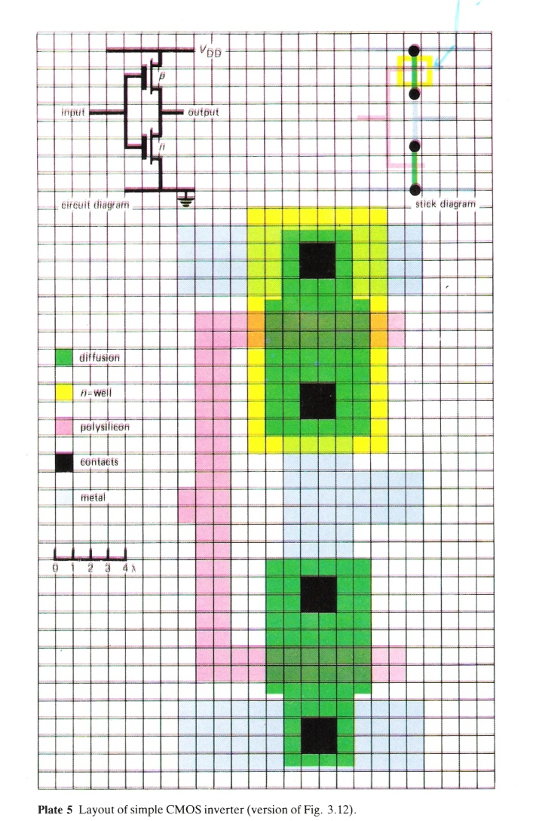
Intro. VLSI: CMOS inverter

Slide 3
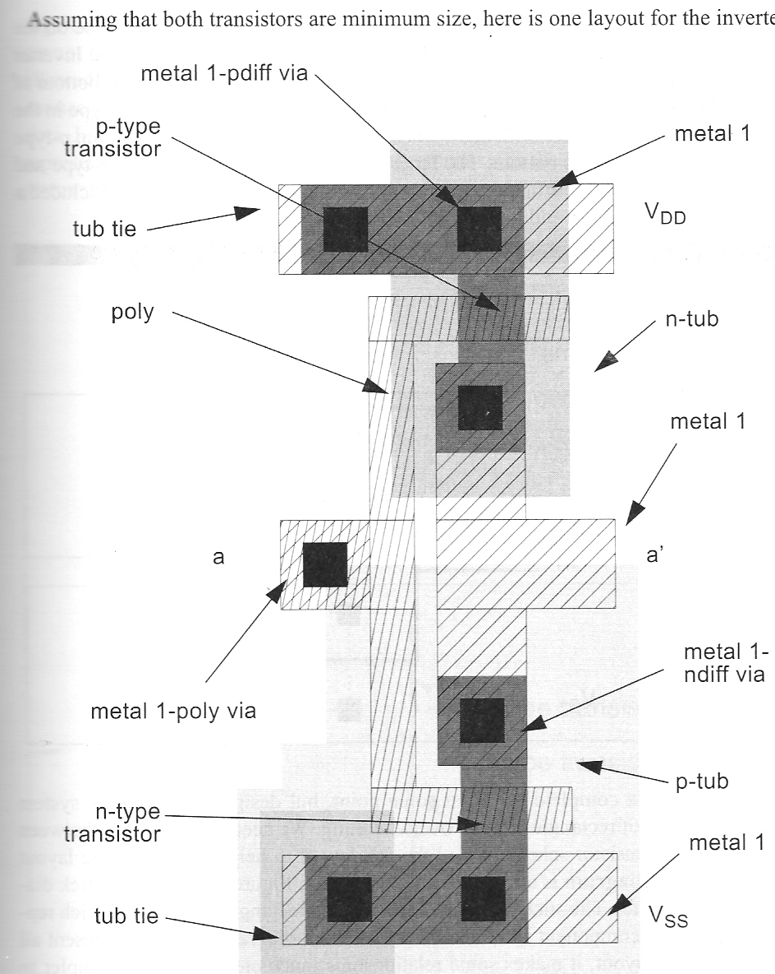
CMOS inverter: black and white representation

Slide 4
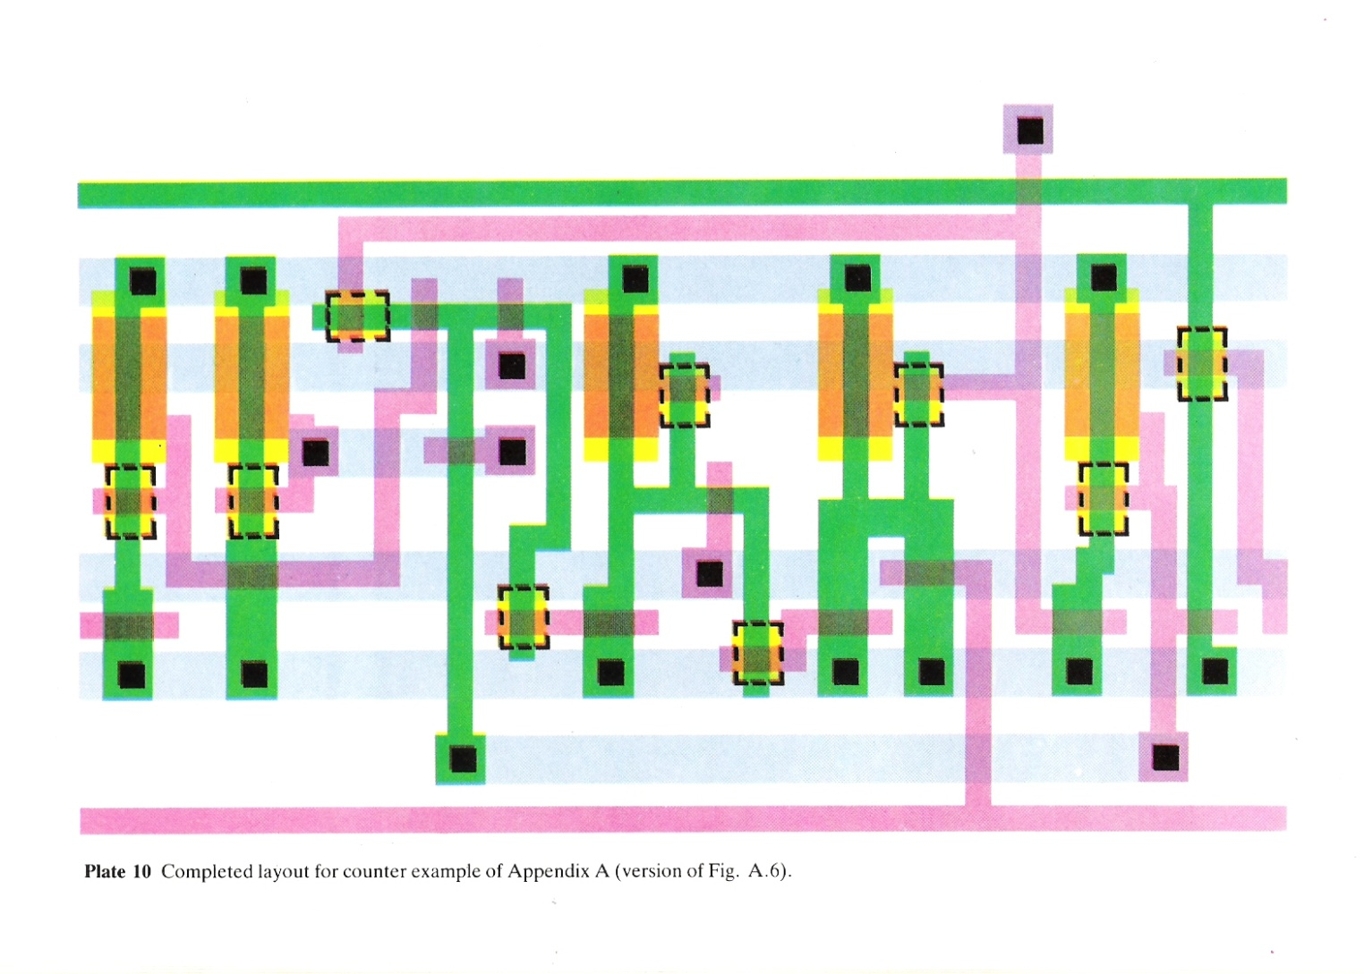
A counter layout

Slide 5
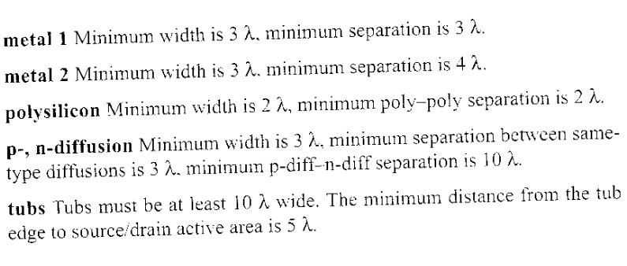
Rules for design rule checking: basic rules

Slide 6
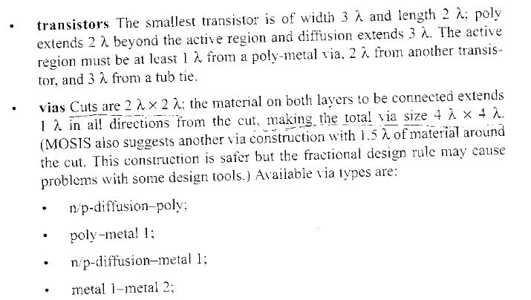
Rules for composition

Slide 7
Concept of the State Machine
Example: Odd Parity Checker
Next State/Output Functions
NS = PS xor PI; OUT = PS
D FF Implementation
T FF Implementation
Timing Behavior: Input 1 0 0 1 1 0 1 0 1 1 1 0

Slide 8
State Behavior of R-S Latch
Truth Table Summary
of R-S Latch Behavior

Slide 9
Sequential Switching Networks
D-FlipFlop
Edge triggered device sample inputs on the event
edge
7474
D
Q
Clk
Positive edge-triggered
flip-flop
Bubble here
for negative
edge triggered
device

Slide 10
Cascaded Flipflops and Setup/Hold/Propagation Delays
Shift Register
S,R are preset, preclear
New value to first stage
while second stage
obtains current value
of first stage
Correct Operation,
assuming positive
edge triggered FF

Slide 11
Design Procedure
Excitation Tables: What are the necessary inputs to cause a
particular kind of change in state?

Slide 12
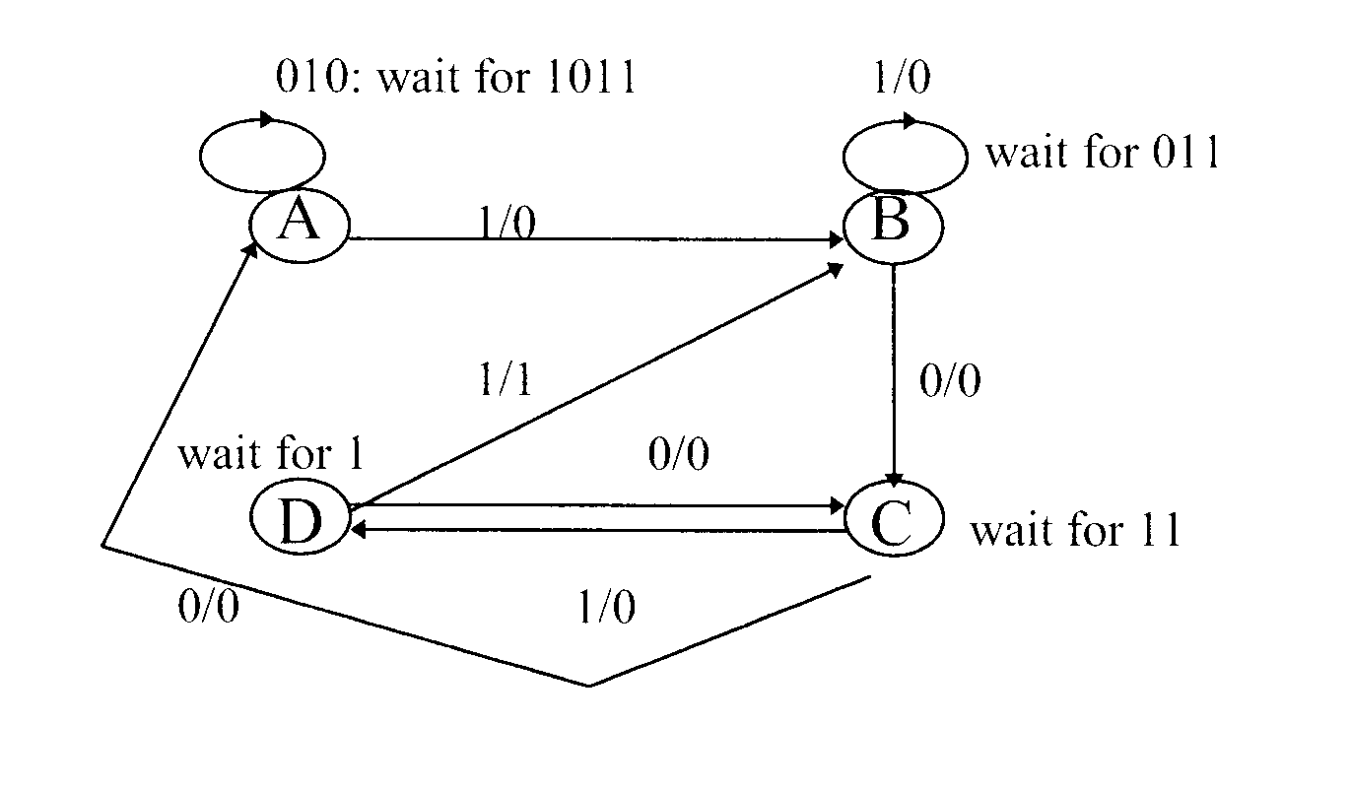
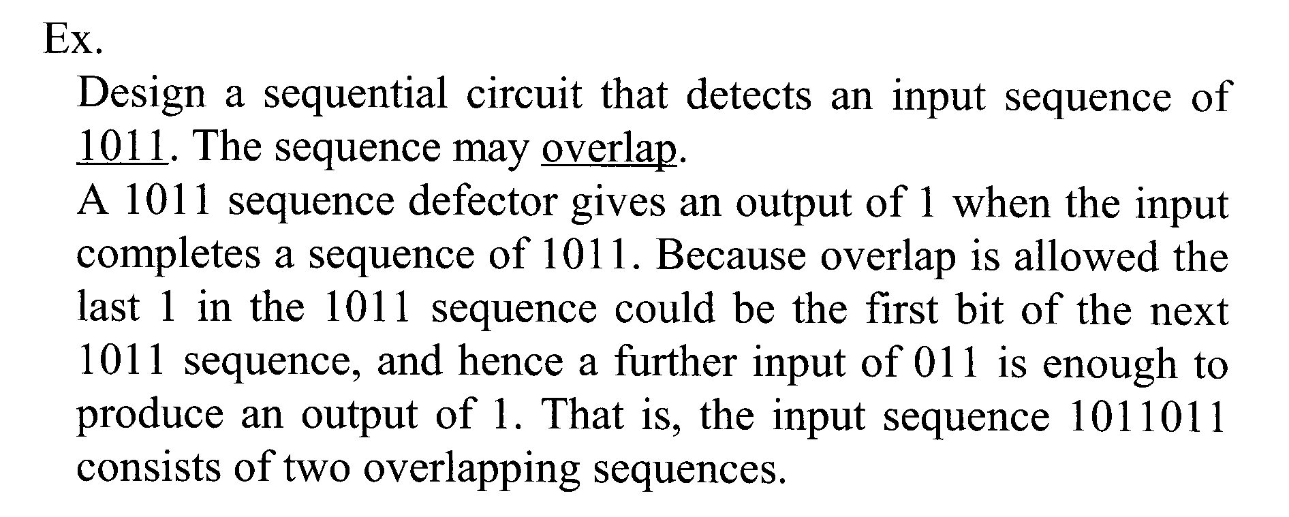

Slide 13
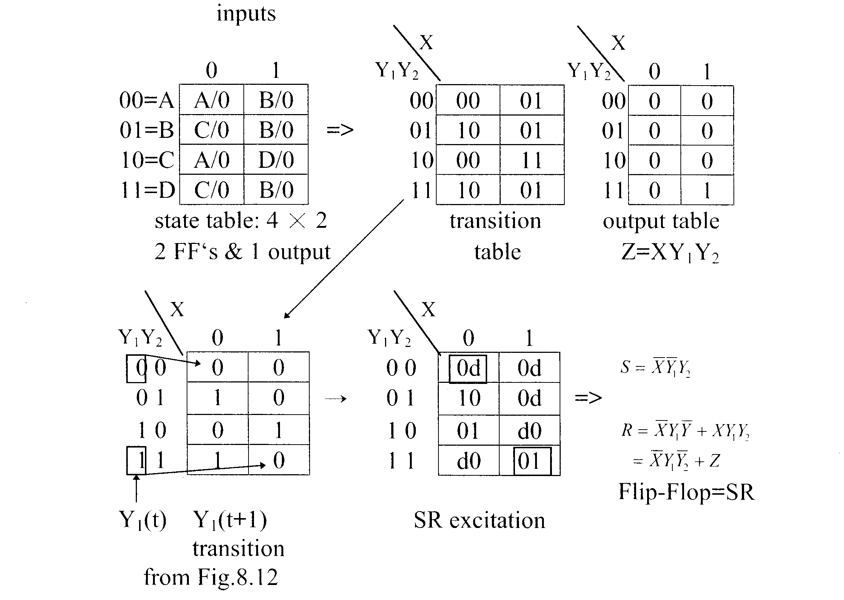

Slide 14
